Slide 1
Secure Data Hiding in Images Using Steganography
CAPSTONE PROJECT
Presented By
Student Name : Soudam Harshavardhan
College Name & Department : Malla Reddy University CSE – Cyber Security

Slide 2
OUTLINE
Problem Statement
Technology used
Wow factor
End users
Result
Conclusion
Git-hub Link
Future scope

Slide 3
Problem Statement
The project aims to develop a secure image steganography application that allows users to:
Hide confidential text messages within digital images using the Least Significant Bit (LSB) technique
Encrypt the hidden messages using password-based Fernet encryption for additional security
Provide a user-friendly graphical interface for encoding and decoding operations
Support multiple image formats (PNG, JPG, BMP) while ensuring the hidden data remains visually imperceptible
The solution combines steganography with modern cryptography to achieve both message hiding and encryption, making it suitable for secure communication through digital images.

Slide 4
Technology used
Programming Language: Python 3.x
GUI Framework: Tkinter (tk)
Core Libraries:
OpenCV (cv2) - Version 4.9.0.80
Cryptography - Version 42.0.5
Pillow (PIL) - Version 10.2.0

Slide 5
Wow factors
Dual-Layer Security
Combines LSB steganography with Fernet encryption and SHA-256 password hashing.
Provides military-grade protection for hidden messages.
Professional GUI & UX
Modern interface with real-time image preview, tooltips, and visual feedback.
Intuitive workflow with error handling and user guidance.
Technical Excellence
Multi-format support (PNG, JPG, BMP) with OpenCV-powered efficient processing.
Smart validation and memory management for robust operation.
Production-Ready Implementation
Enterprise-level code organization with proper error handling.
Maintains data integrity through automatic PNG conversion.

Slide 6
End users
The primary end users of this secure image steganography application are individuals and professionals who need to communicate sensitive information securely, including journalists, activists, and whistleblowers who require confidential communication channels. Business professionals and organizations can utilize this tool for sharing proprietary information or sensitive corporate data through seemingly innocent image files. Students and educators in the fields of cybersecurity and cryptography can use this application as a practical learning tool to understand steganography and encryption concepts. Digital privacy enthusiasts and security-conscious individuals who want to protect their personal communications from unauthorized access will find this tool valuable. Additionally, the user-friendly interface makes it accessible to non-technical users who need to securely share sensitive information while maintaining plausible deniability through normal-looking image files.

Slide 7
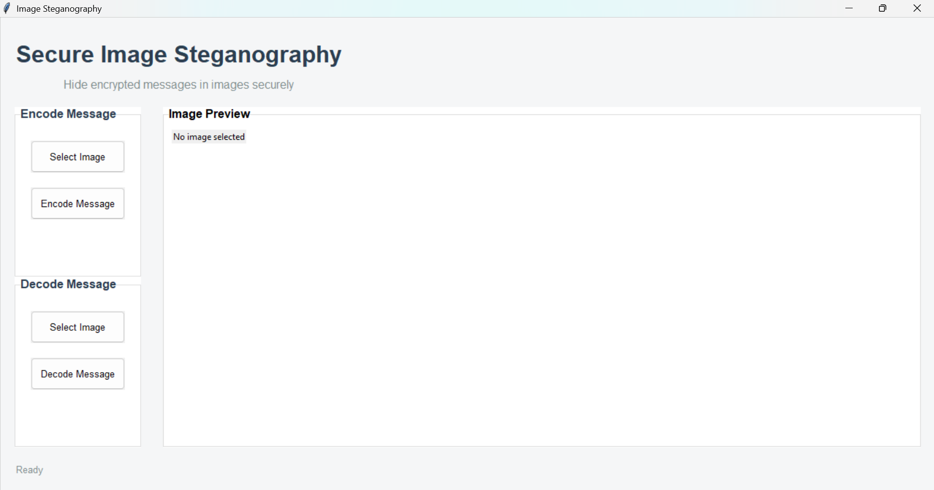
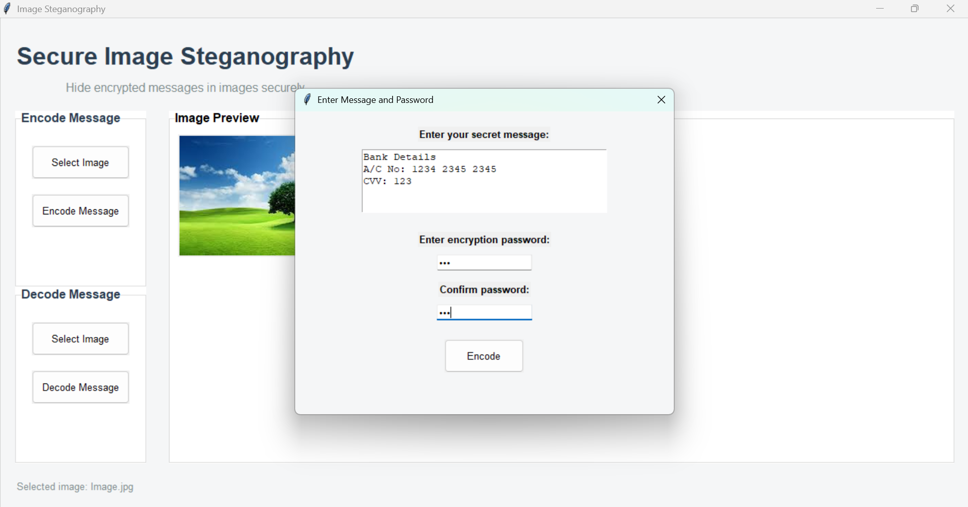
Results

Slide 8
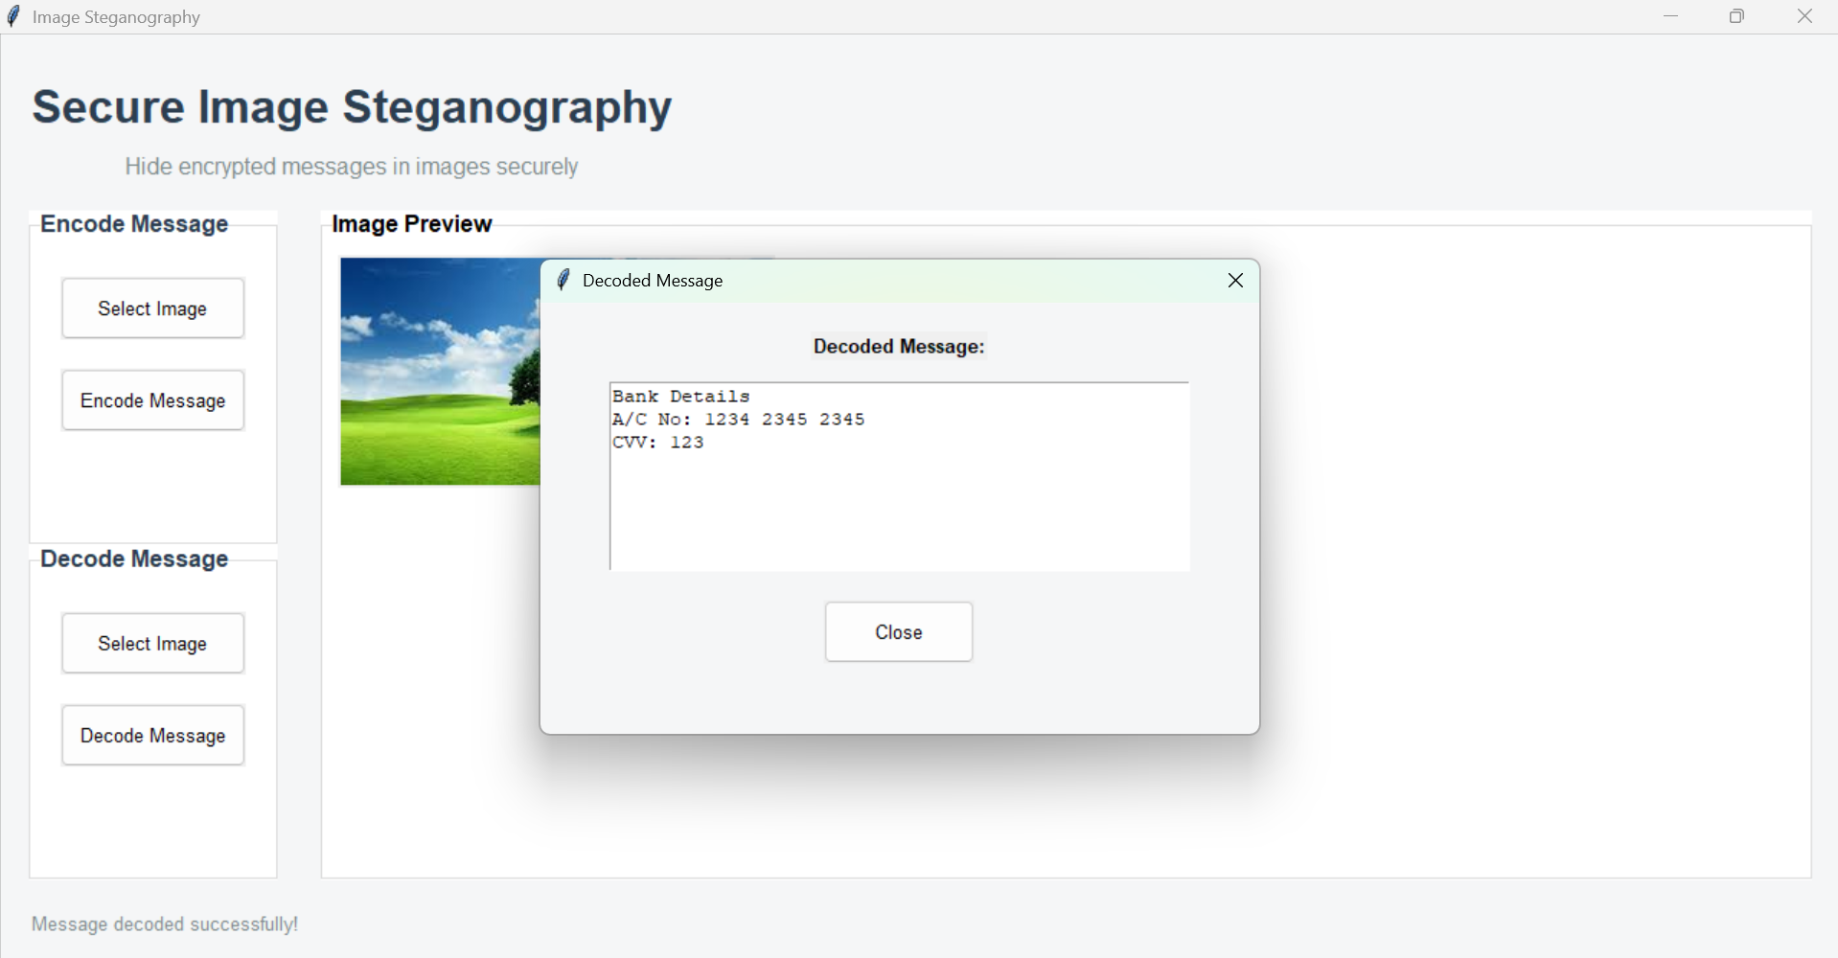
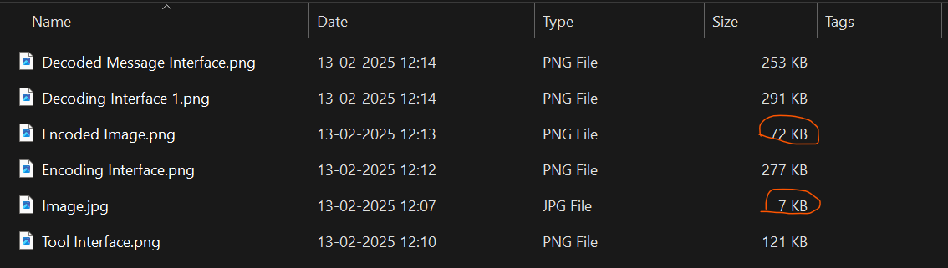
Results

Slide 9
Conclusion
The Secure Image Steganography project successfully implements a robust solution for hiding sensitive information within digital images, combining the power of LSB steganography with modern encryption techniques. The application's dual-layer security approach, utilizing both steganography and Fernet encryption with password protection, ensures that hidden messages remain confidential and secure from unauthorized access. The modern, user-friendly graphical interface, complete with real-time image preview and intuitive controls, makes advanced security technology accessible to both technical and non-technical users. The project demonstrates practical implementation of security concepts while maintaining high performance through efficient image processing using OpenCV, making it suitable for real-world applications in secure communication. By focusing on both security and usability, this project serves as a valuable tool for various user groups, from privacy-conscious individuals to organizations requiring secure data transmission, while also serving as an educational resource for understanding steganography and cryptography concepts.

Slide 10
GitHub Link
https://github.com/harsha-soudam/ImageStego

Slide 11
Future scope(optional)
The project can be enhanced by implementing advanced steganography techniques like DCT (Discrete Cosine Transform) and DWT (Discrete Wavelet Transform) to increase data capacity and resistance against steganalysis attacks, while also adding support for hiding messages in audio and video files. Integration of blockchain technology could provide an additional layer of security and verification, ensuring message authenticity and maintaining an immutable record of steganographic communications. The application could be extended to include a secure cloud-based sharing system with end-to-end encryption, mobile platform support through cross-platform development, and advanced features like steganographic watermarking for copyright protection and digital rights management.

Slide 12
THANK YOU

